Slide 1



Practical Notes in using Direct Oral Anticoagulants (DOACs) in Stroke Patients with Atrial Fibrillation
Mehdi Farhoudi, MD,
Professor of Neurology,
Tabriz University of Medical Sciences,
World Stroke Organization Board Member,
Tabriz, Iran

Slide 3
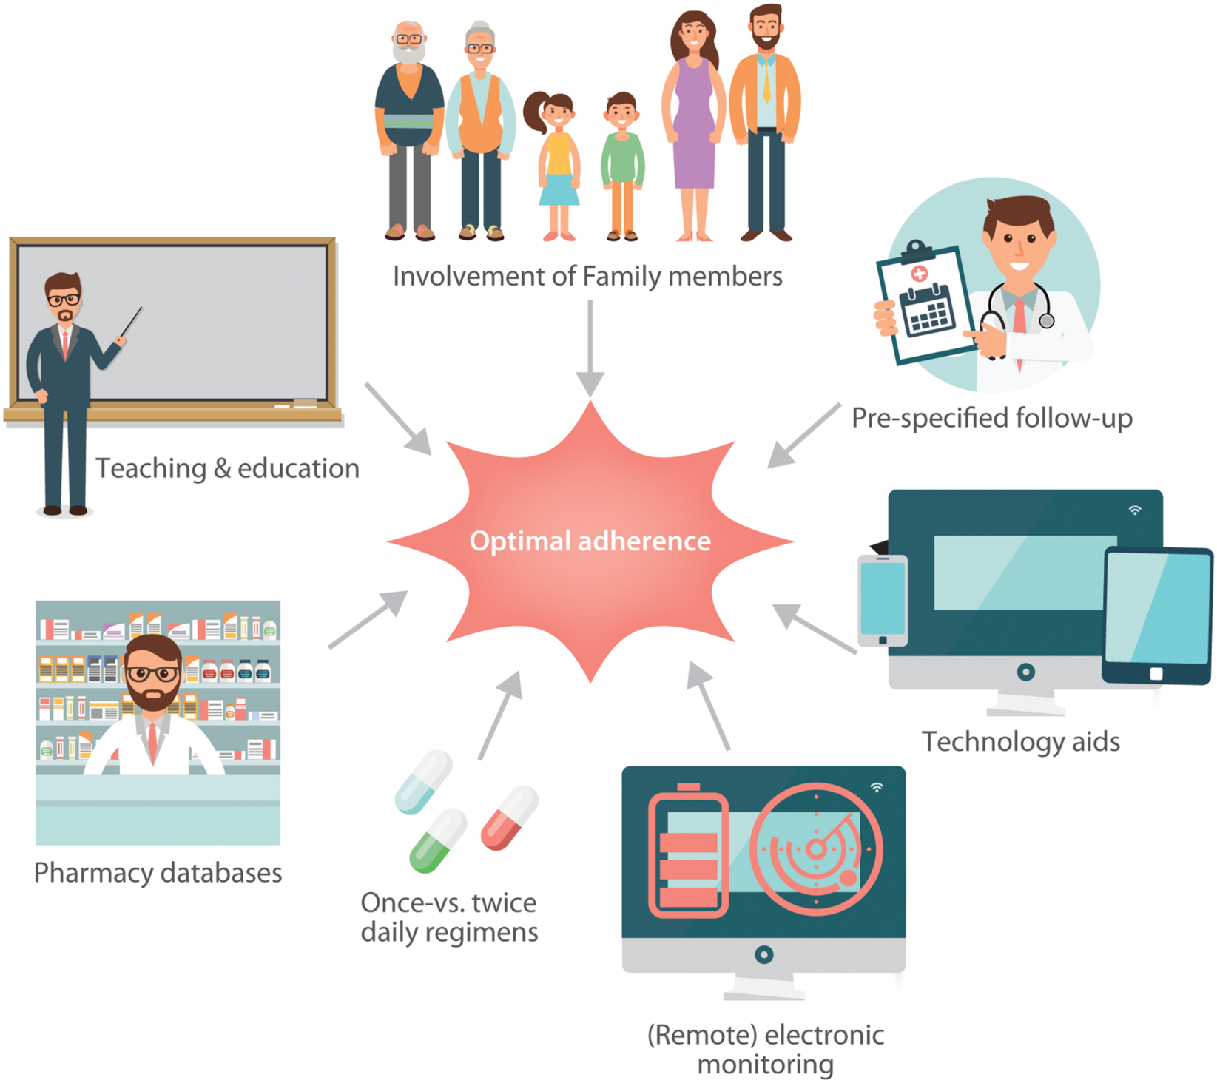
Notes:
Figure 2 Selection of possibilities to increase adherence to NOACs. NOAC, non-vitamin K antagonist oral anticoagulant.
3

Slide 4
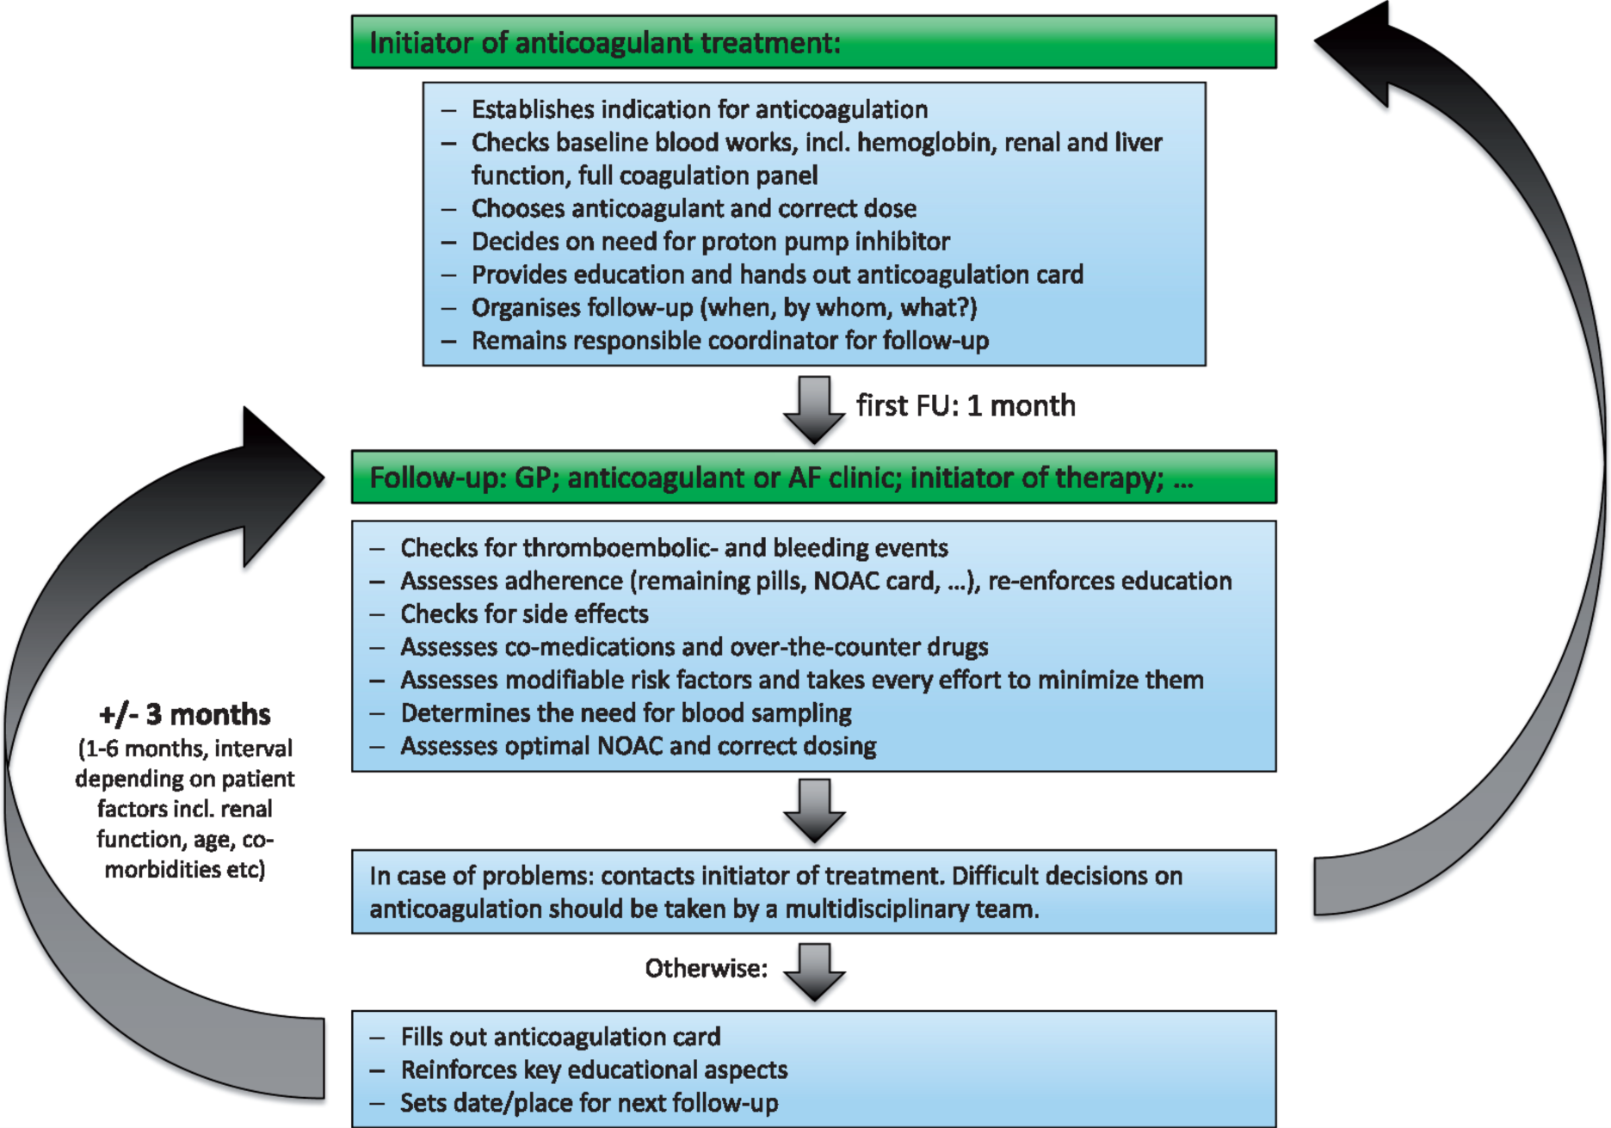

Slide 5
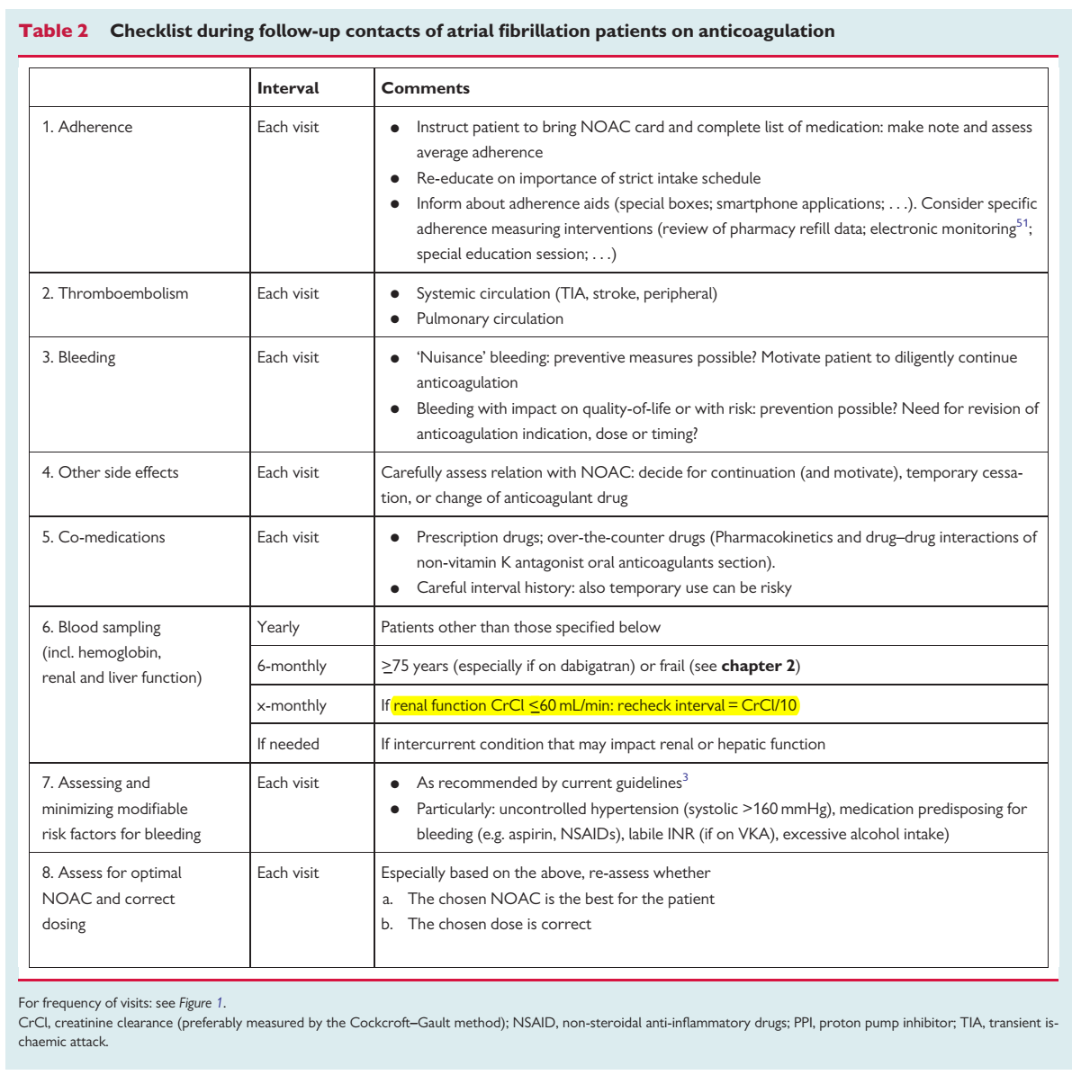

Slide 6
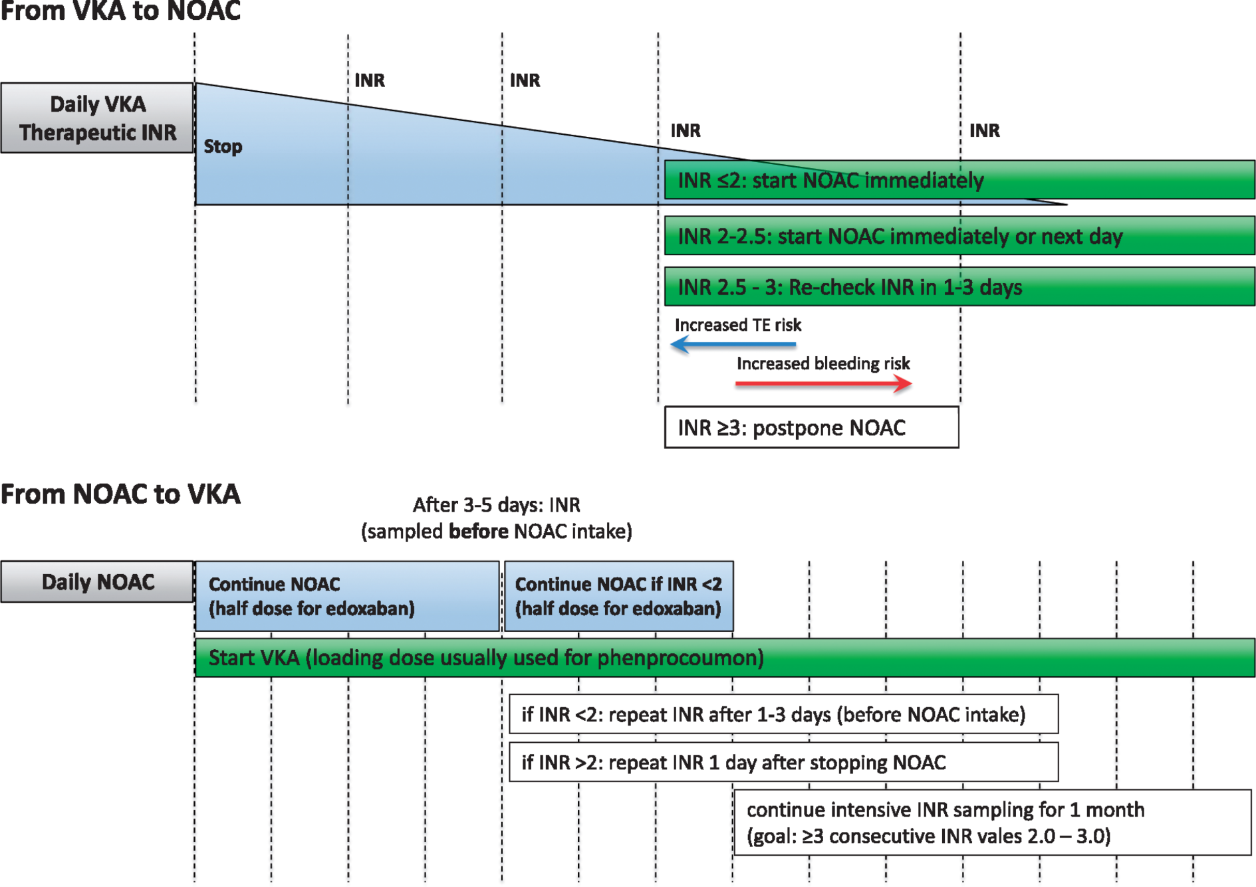
Switch by LMWH in high TE event situation.
Notes:
Switching between anticoagulant regimens: Because of the slow onset of action of VKAs, it may take 5–10 days before the INR is in the therapeutic range, with large individual variations. Therefore, the NOAC and VKA should be administered concomitantly until the INR is in a range that is considered appropriate. similar to the situation when low molecular weight heparins (LMWHs) are administered during VKA initiation. A loading dose is not recommended for acenocoumarol and warfarin, but is appropriate with phenprocoumon. When concomitant administration of a NOAC during the initiation of the VKA is not deemed appropriate, initiation of the VKA can be performed after switching the NOAC to LMWH, which may
be considered especially in patients with a high thromboembolic risk.

Slide 7
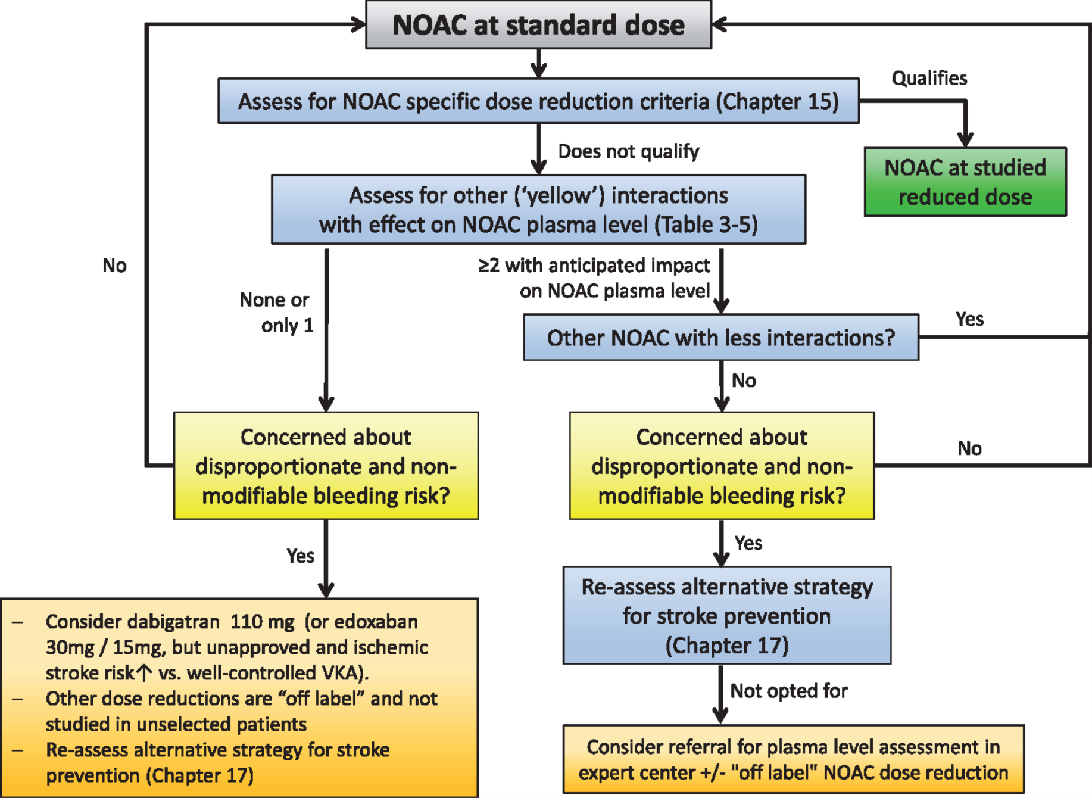
Notes:
Figure 3 NOAC selection based on drug–drug interactions and/or risk of bleeding. Use of plasma level measurements to guide dosing is generally discouraged and should only be used in rare cases of potentially substantial interactions or special situations, and only in centres with great experience in the performance and interpretation of such assays as well as the care of NOAC-treated patients.
7

Slide 8
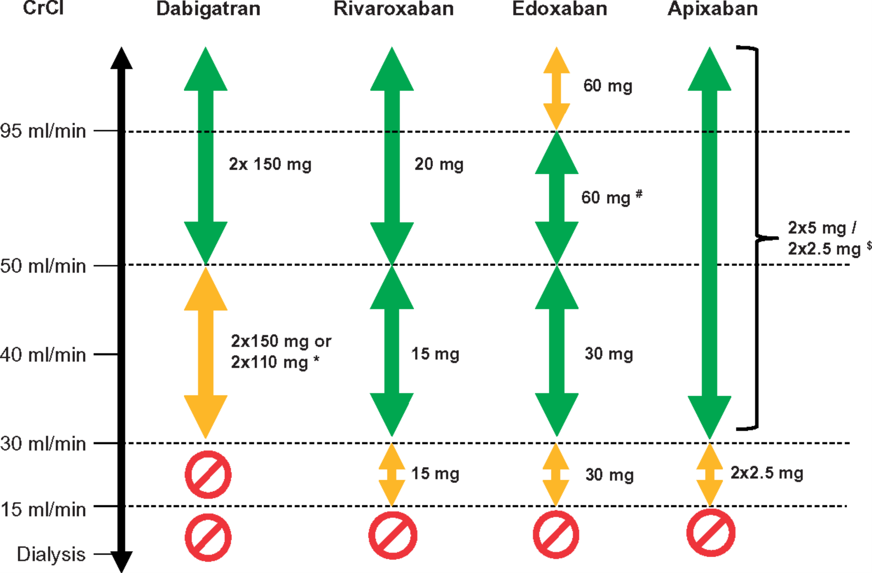
Notes:
Figure 4 Use of non-vitamin K antagonist oral anticoagulants according to renal function. *2 × 110 mg in patients at high risk of bleeding (per SmPc). <sup>#</sup>Other dose reduction criteria may apply (weight ≤60 kg, concomitant potent P-Gp inhibitor therapy). <sup>$</sup>2 × 2.5 mg only if at least two out of three fulfilled: age ≥80 years, body weight ≤60 kg, creatinine ≥1.5 mg/dL (133 µmol/L). Orange arrows indicate cautionary use (dabigatran in moderate renal insufficiency, FXa inhibitors in severe renal insufficiency, edoxaban in ‘supranormal’ renal function); see text for details.
8

Slide 9
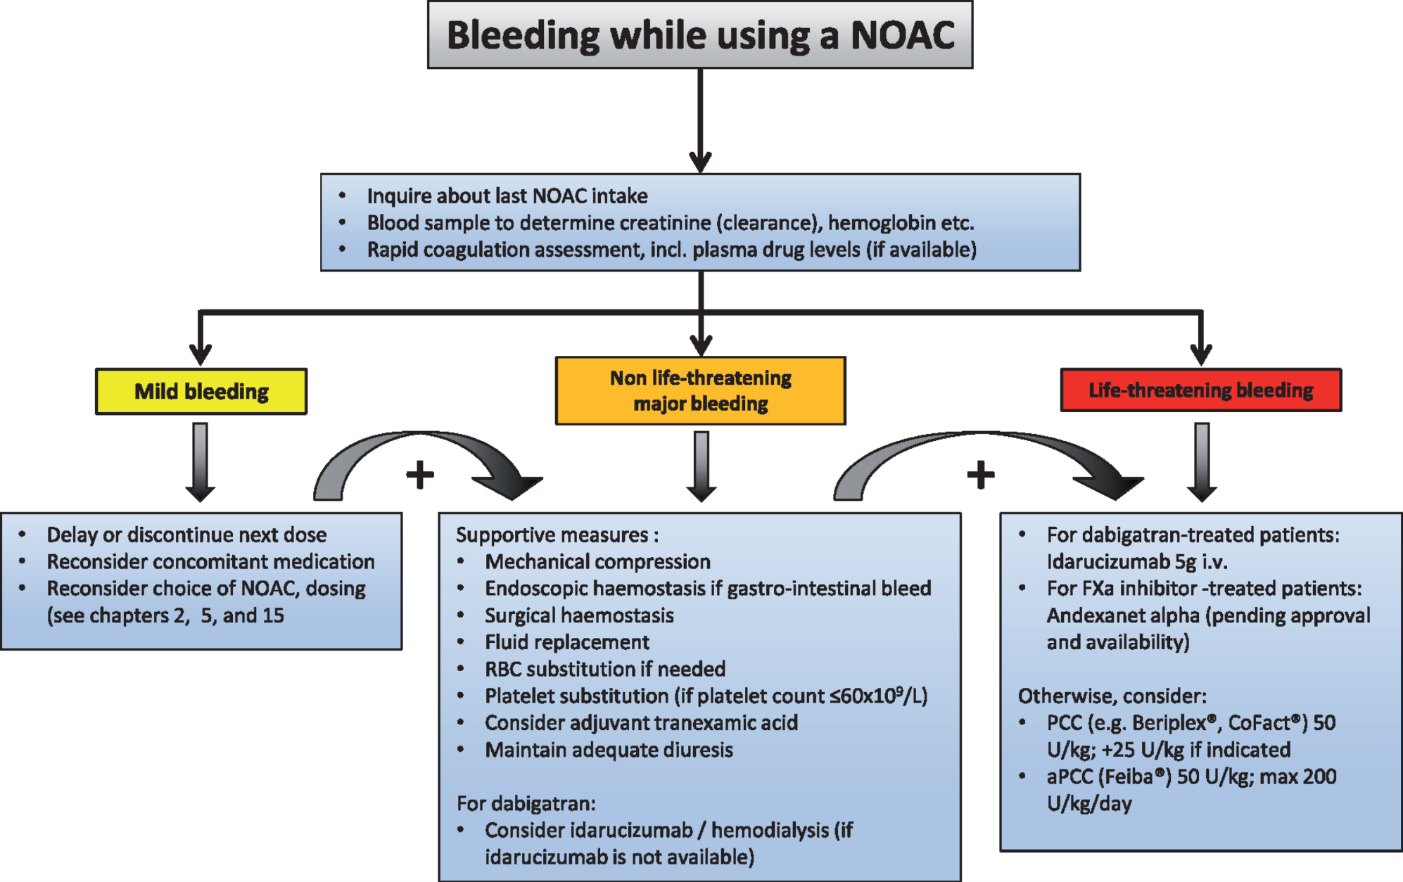
Notes:
Figure 5 Management of bleeding in patients taking non-vitamin K antagonist oral anticoagulants.
9

Slide 10
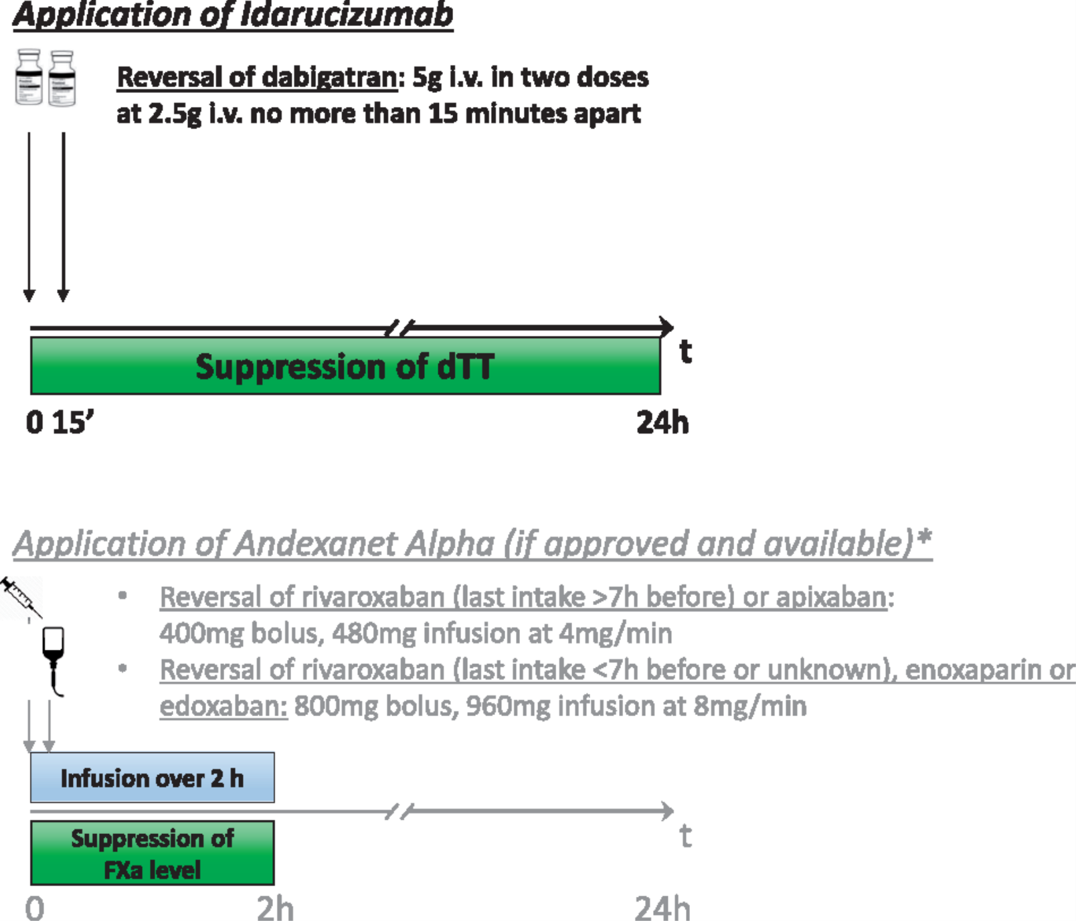
Notes:
Figure 6 Application and effect of idarucizumab and andexanet alpha. *Per protocol of ANNEXA-4.<sup>249</sup> Andexanet alpha: The outcome study (ANNEXA-4) is still pending, the drug is not yet approved and not yet available.
10

Slide 11
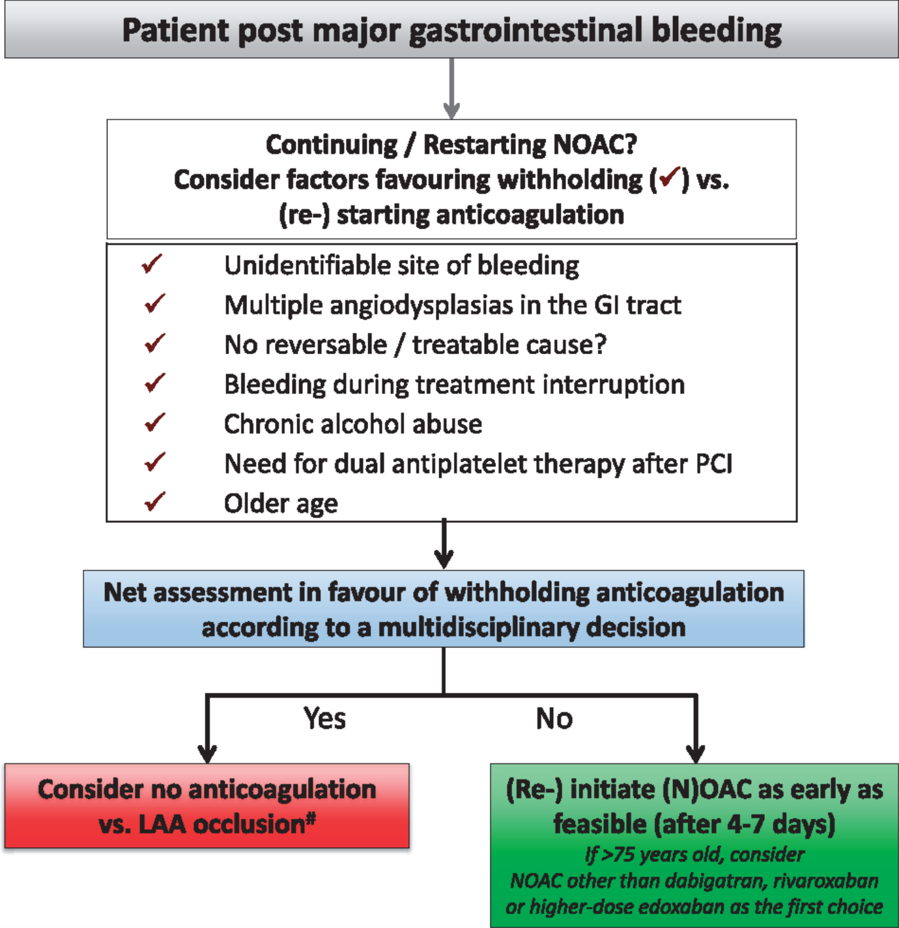
Notes:
Figure 7 (Re-) initiation of anticoagulation post-gastrointestinal bleeding. <sup>#</sup>Without evidence; ideally include patient in ongoing trial.
11

Slide 12
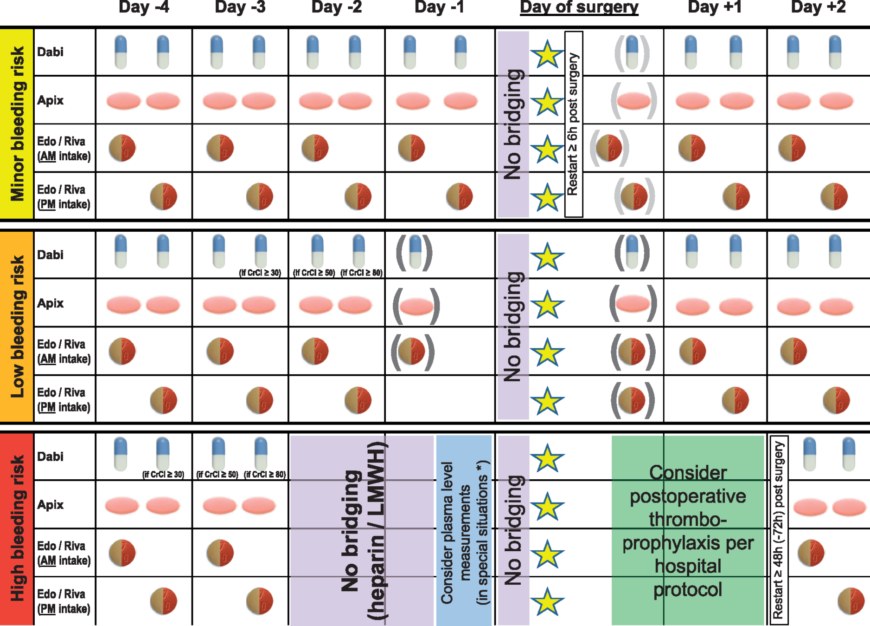
Notes:
Figure 8 Stopping and re-initiation of non-vitamin K antagonist oral anticoagulant therapy in elective surgery. Yellow star, time point of the intervention/operation. Consider +24 h of interruption in situations likely resulting in increased plasma levels [e.g. patients taking verapamil, body weight <50 kg, significant interactions (see chapter 5)]. *Consider measurement of plasma levels (see chapter 7) in very special situations, e.g. highest risk neurosurgery/cardiac surgery, severe renal insufficiency, and combination of factors predisposing to higher non-vitamin K antagonist oral anticoagulant levels (see chapter 5). Rivaroxaban needs to be taken with food for stroke prevention in atrial fibrillation, which needs to be looked after (also) in the post-operative setting. Apix, apixaban; CrCl, creatinine clearance; Dabi, dabigatran; Edo, edoxaban; LMWH, low molecular weight heparin; Riva, rivaroxaban.
12

Slide 13
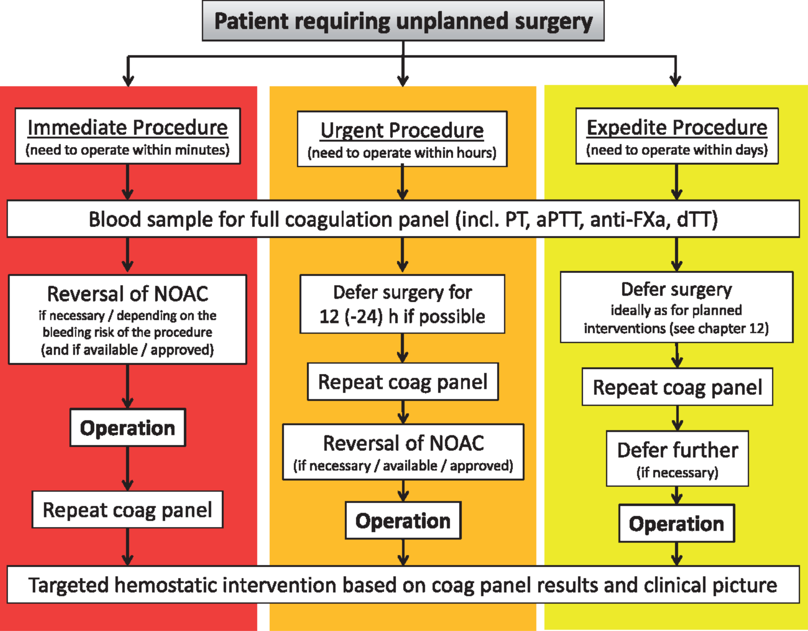
Notes:
Figure 9 Non-vitamin K antagonist oral anticoagulant management in the setting of unplanned surgery.
13

Slide 14
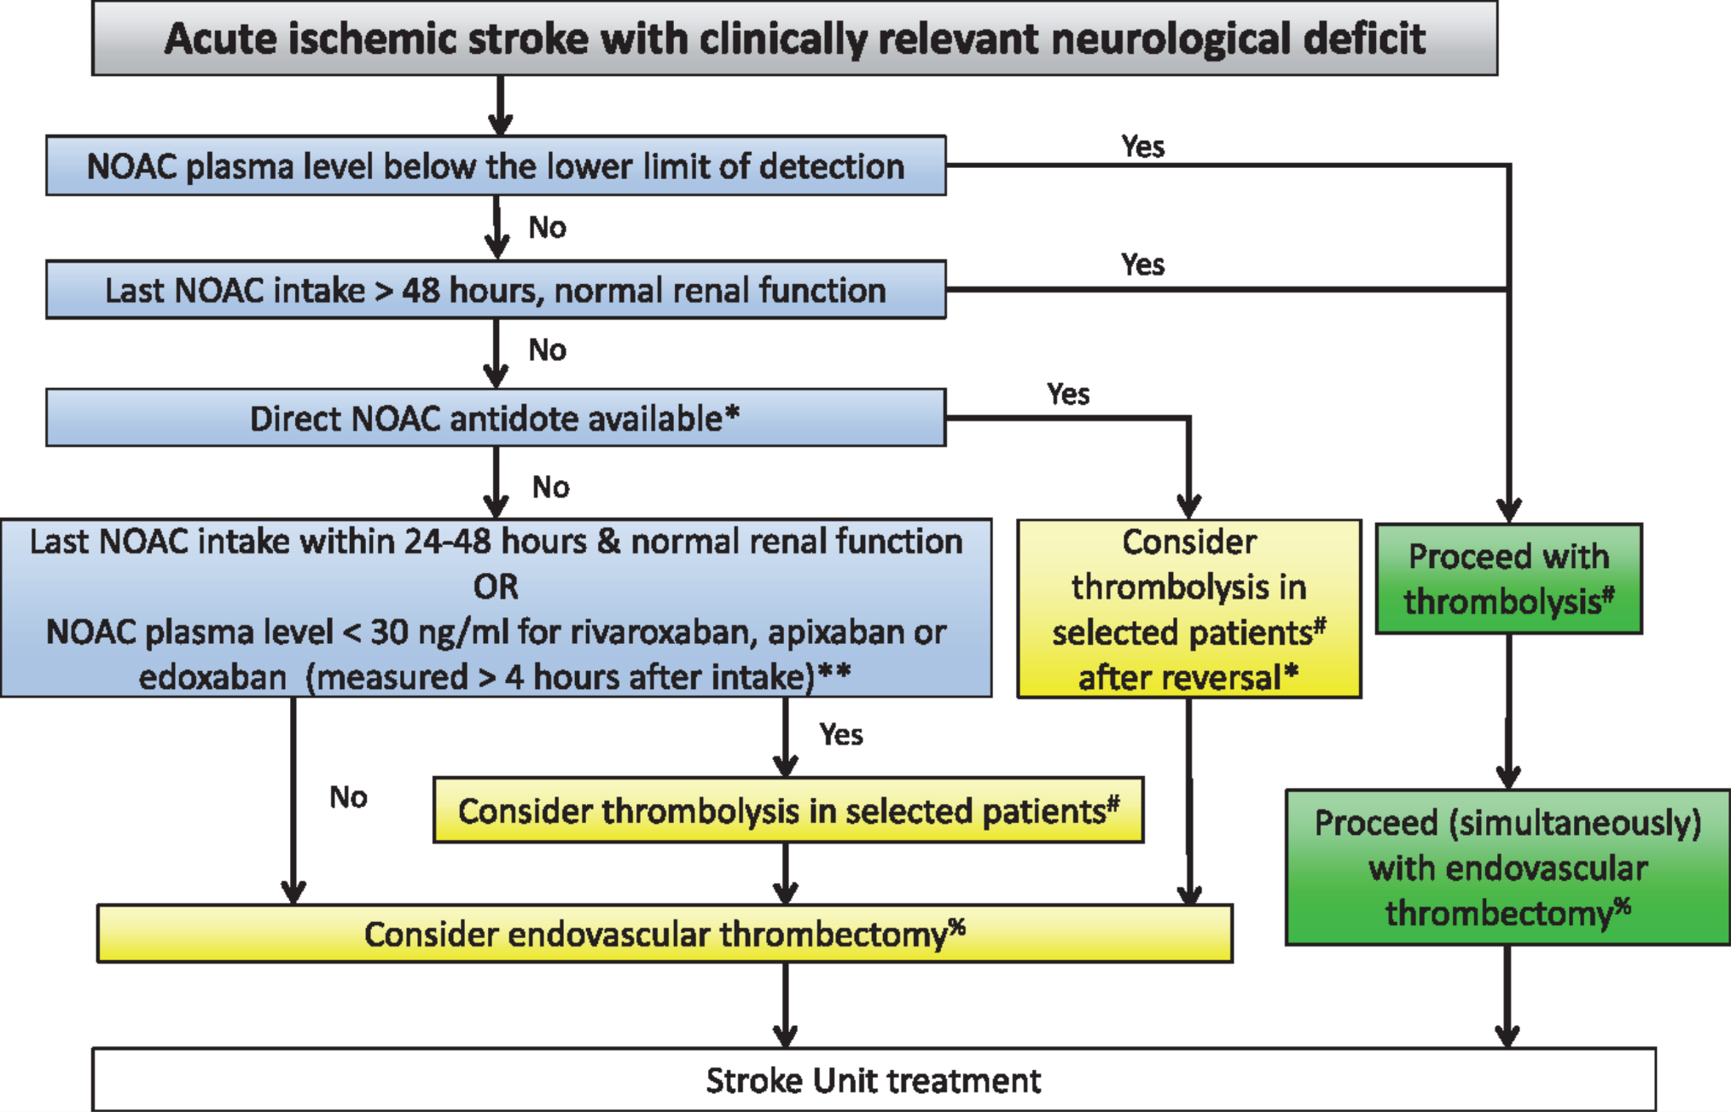
Notes:
Figure 13 Acute management of acute ischaemic stroke in a patient on non-vitamin K antagonist oral anticoagulant. *Currently only available for dabigatran (idarucizumab). <sup>#</sup>Perform systemic thrombolysis only if there are no (other) contraindications for intravenous application of recombinant tissue plasminogen activator according to its label. <sup>%</sup>Perform endovascular thrombectomy only if there is a target vessel occlusion and procedure is indicated and feasible according to present evidence. **According to expert consensus.<sup>370</sup>
14

Slide 15
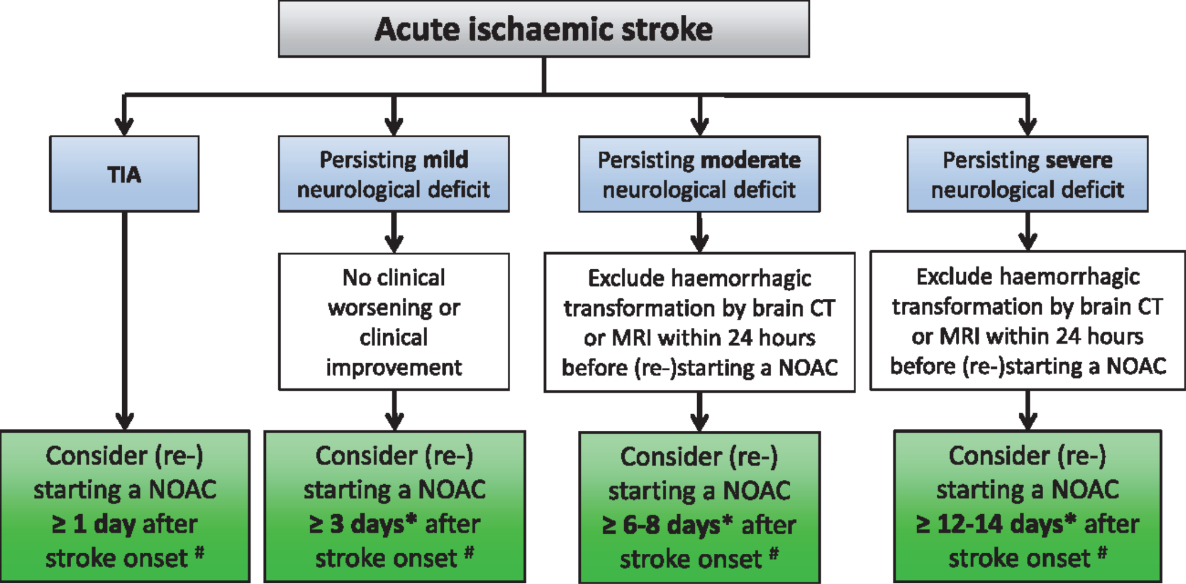
Notes:
Figure 14 (Re-) initiation of anticoagulation after transient ischaemic attack/stroke. (Re-) start only in the absence of contraindications and if stroke size is not expected to substantially increase the risk of secondary haemorrhagic transformation. *Consider shorter delays to (re-) start a non-vitamin K antagonist oral anticoagulant if there is a very high risk of stroke recurrence (e.g. left atrial appendage thrombus) and no haemorrhagic transformation on follow-up brain imaging (using computed tomography or magnetic resonance imaging). Consider longer delays to (re-)start a non-vitamin K antagonist oral anticoagulant according to the recommendations made in the European Society of Cardiology Atrial Fibrillation Guidelines 2016. <sup>#</sup>Without proven evidence; consider inclusion of patient in an ongoing trial.
15

Slide 16
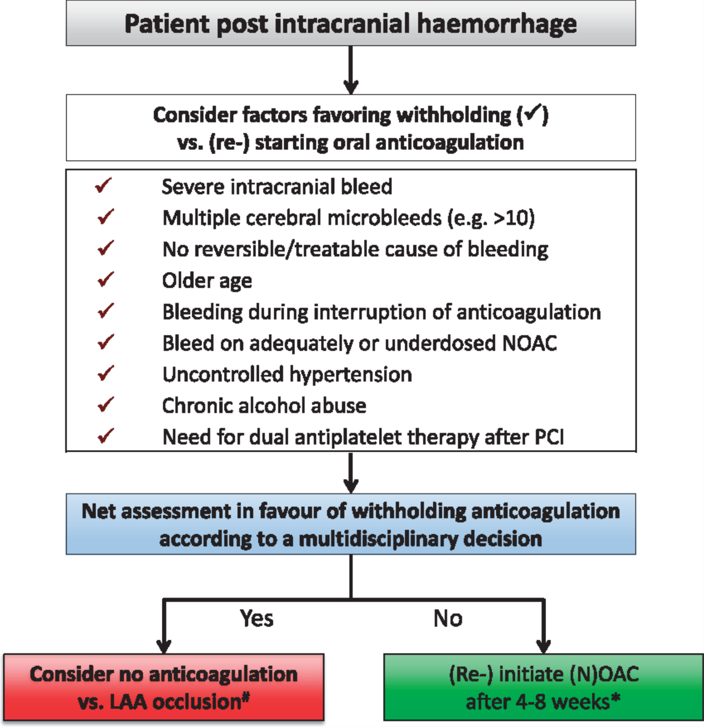
Notes:
Figure 15 (Re-) initiation of anticoagulation post intracranial bleeding. <sup>#</sup>Without evidence; ideally include the patient in an ongoing trial. *Brain imaging (CT/MRI) should be considered before (re-)initiation of (non)-vitamin K antagonist oral anticoagulant.
16

Slide 17



Thanks for your attention

